Slide 1

Introduction to Computer Organization
Computer organization is the study of how the components of a computer system are interconnected and how they work together. This field delves into the architecture, structure, and functionality of the fundamental parts of a computer, laying the groundwork for understanding how programs execute and data is processed.
SV
by Sowmiya Vijayan

Slide 2

Fundamental Concepts: Operators and Operands
1
Operators
2
Operands
Operators are special symbols that perform specific operations on data.
Operands are the values or variables that operators act upon.
3
Expressions
4
Evaluation
Operators and operands combined form expressions, which represent calculations or logical statements.
Expressions are evaluated based on operator precedence and associativity rules.

Slide 3
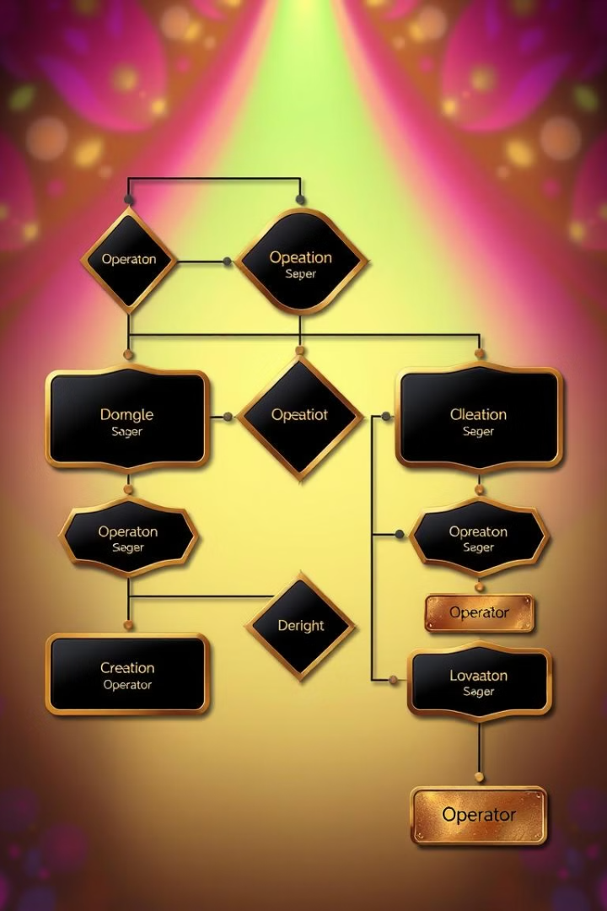
Types of Operators in Computer Organization
Arithmetic
Logical
Perform mathematical operations like addition, subtraction, multiplication, and division.
Work with Boolean values (true or false) and perform operations like AND, OR, and NOT.
Bitwise
Relational
Operate on individual bits of data, performing operations like AND, OR, XOR, and NOT on binary representations.
Compare values and return a Boolean result based on relationships like equality, inequality, greater than, and less than.

Slide 4
Arithmetic Operators
Addition (+)
Subtraction (-)
Multiplication (*)
Adds two operands together.
Subtracts the second operand from the first.
Multiplies two operands together.

Slide 5
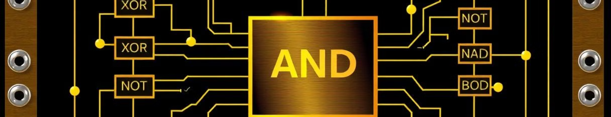



Logical Operators
AND (&)
OR (|)
NOT (!)
Returns true only if both operands are true.
Returns true if at least one operand is true.
Inverts the truth value of an operand, returning true if the operand is false and vice versa.

Slide 6

Bitwise Operators
AND (&)
Performs a bit-by-bit AND operation, resulting in a 1 only if both corresponding bits are 1.
OR (|)
Performs a bit-by-bit OR operation, resulting in a 1 if at least one corresponding bit is 1.
XOR (^)
Performs a bit-by-bit XOR operation, resulting in a 1 only if the corresponding bits are different.
NOT (~)
Inverts the bits of an operand, flipping 0s to 1s and vice versa.

Slide 7





Relational Operators
Equal to (==)
Not equal to (!=)
Greater than (>)
Less than (<)
Returns true if both operands are equal.
Returns true if both operands are not equal.
Returns true if the first operand is greater than the second.
Returns true if the first operand is less than the second.

Slide 8

Conclusion and Key Takeaways
Operators are essential components of computer organization, enabling the manipulation and processing of data. Understanding the different types of operators and their functionality is crucial for writing efficient and effective programs.

Slide 9

THANK YOU

